Slide 1
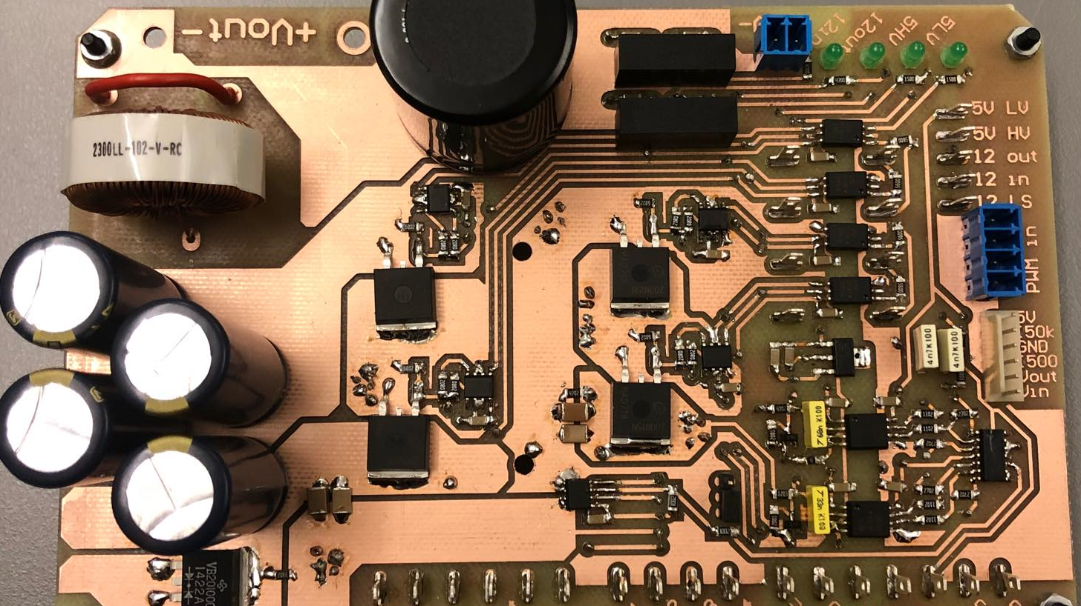
Converter Design
Converter Design

Slide 2
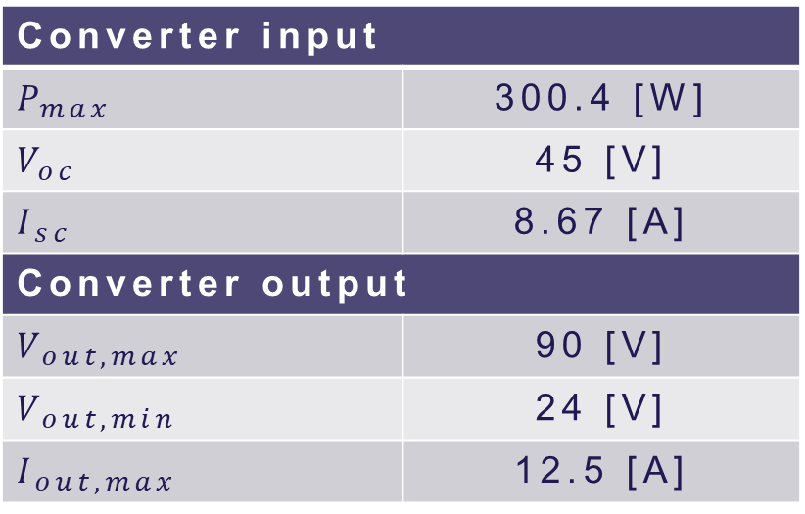
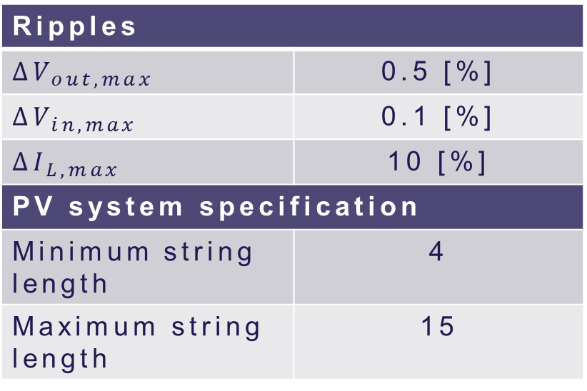
System requirements
Converter input
$$P_{max}$$ | 300.4 [W]
$$V_{oc}$$ | 45 [V]
$$I_{sc}$$ | 8.67 [A]
Converter output
$$V_{out,max}$$ | 90 [V]
$$V_{out,min}$$ | 24 [V]
$$I_{out,max}$$ | 12.5 [A]
Ripples
$$∆V_{out,max}$$ | 0.5 [%]
$$∆V_{in,max}$$ | 0.1 [%]
$$∆I_{L,max}$$ | 10 [%]
PV system specification
Minimum string length | 4
Maximum string length | 15
Notes:
How did we select the values
Input from PV panel
Output from inverter voltage and # of panels
# of panels from minimum and maximum duties
Ripples so we dont mess with the PV panel

Slide 3
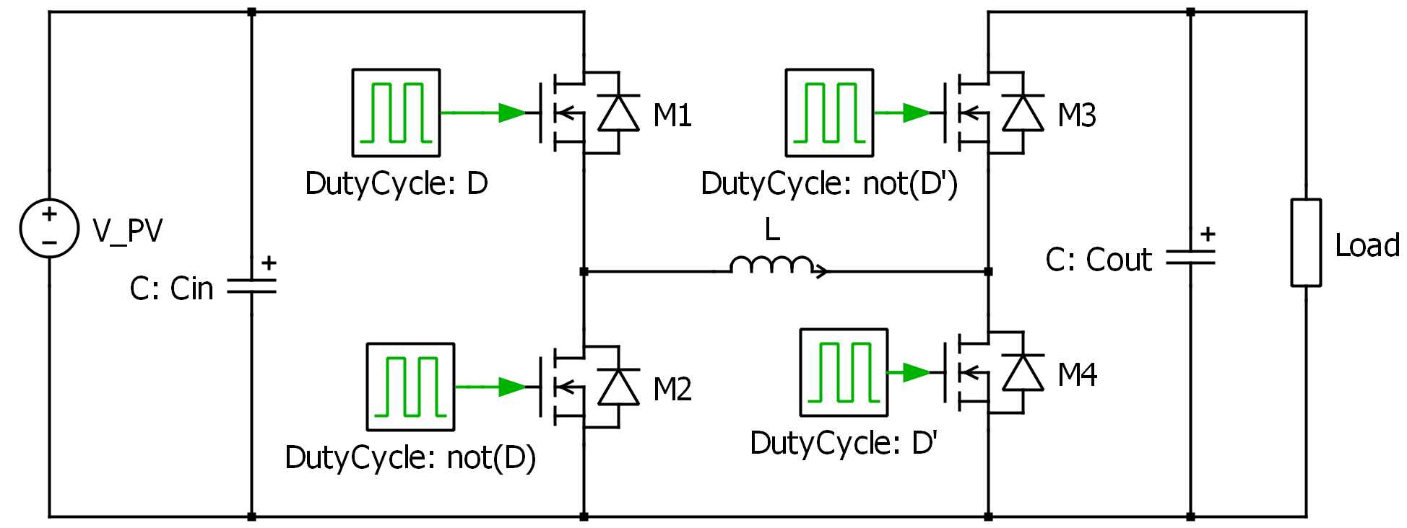
Selection of topology
Non-inverting buck-boost converter
Notes:
Capabilities of both higher and lower output voltage
2 or 4 MOSFETs
Bidirectional opportunities
Lower (conduction) losses

Slide 4
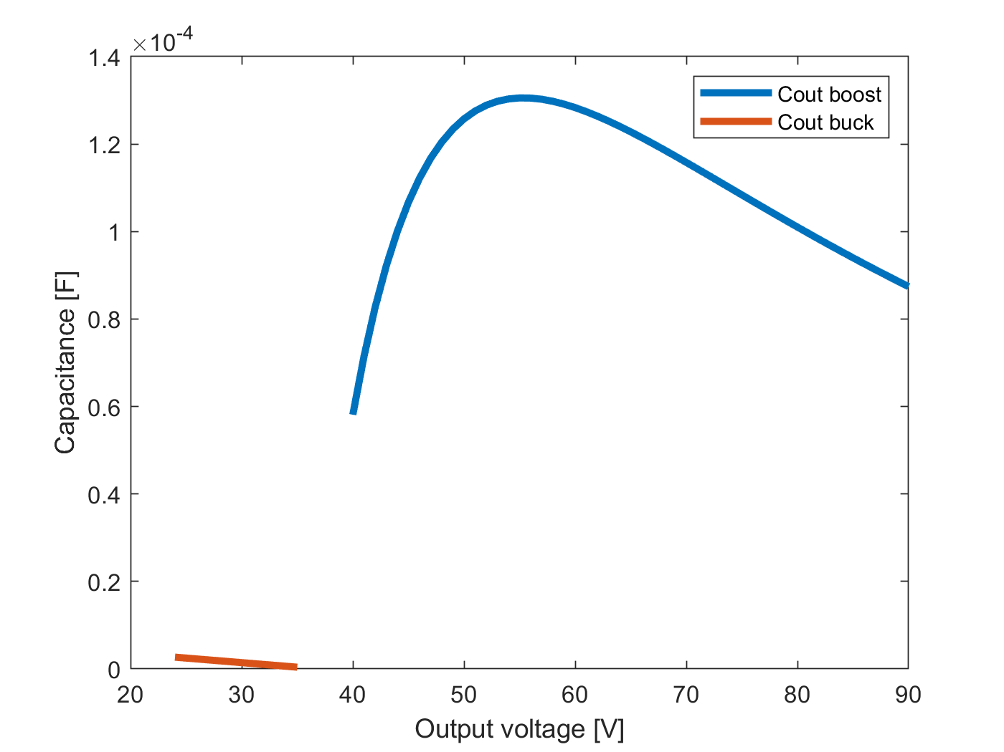
Passive components Sizing
Calculated using the ripples
Defining worst case conditions
Depends on switching frequency
Notes:
Did a voltage sweep to determine worst case

Slide 5
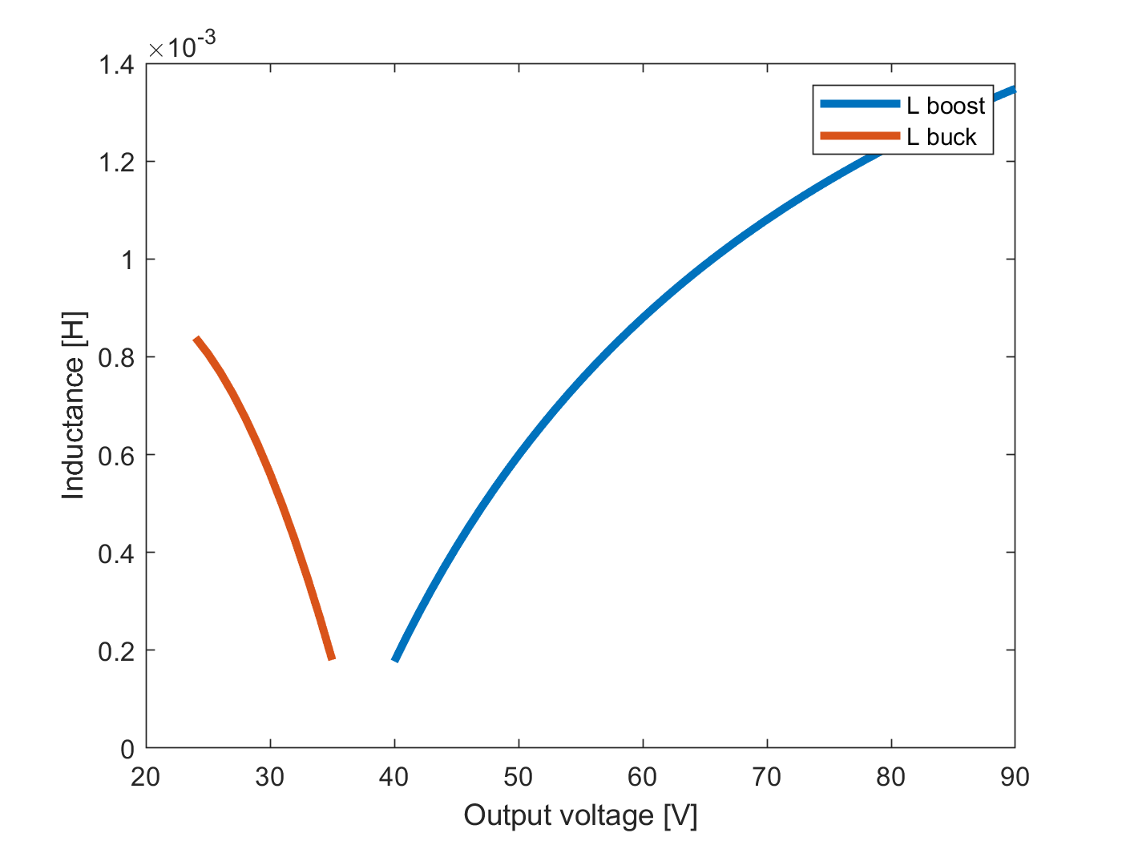
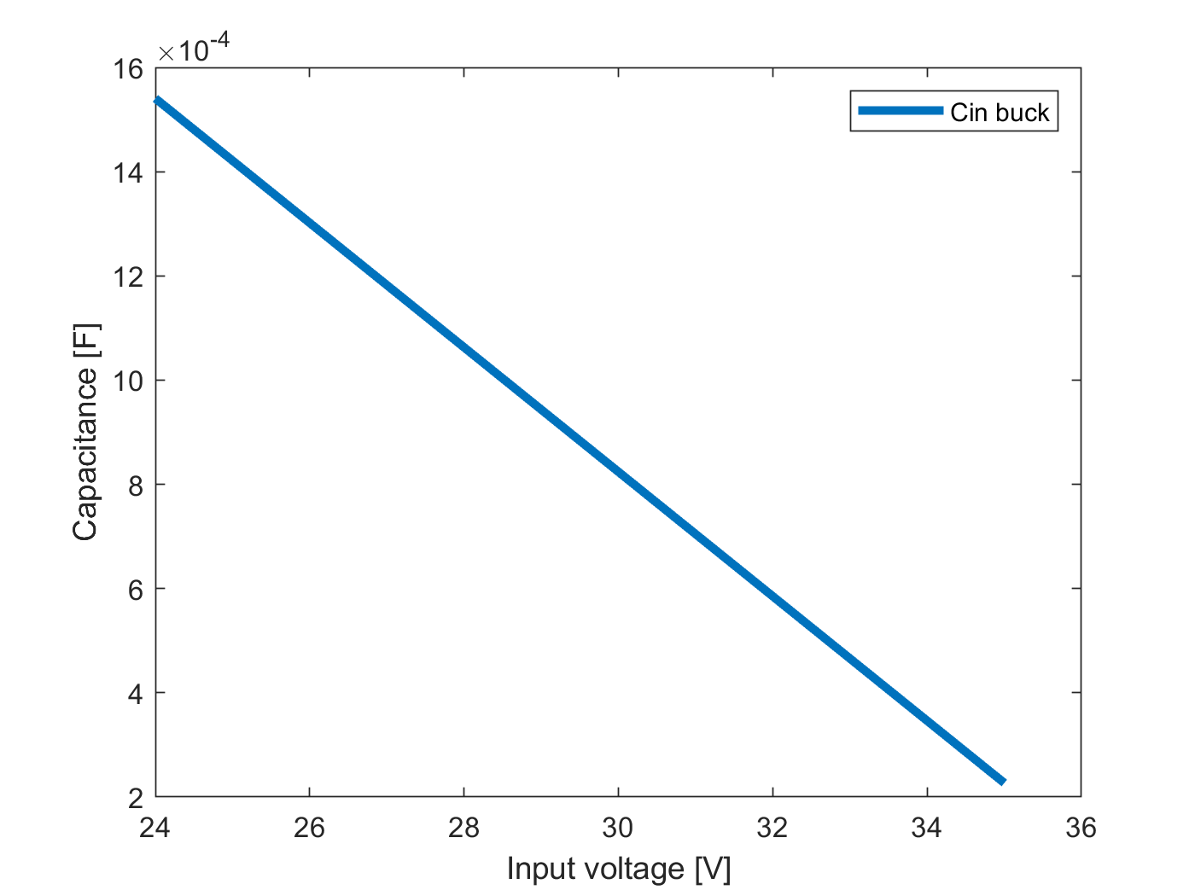
Passive components Sizing

Slide 6
Passive components Selection
Minimum 20% margin was included
Reused inductor
Component | Theoretical value | Implemented value | Voltage rating
Input capacitor | 1540µF | 1880µF | 100V
Output capacitor | 130µF | 820µF | 250V
Inductor | 1.3mH | 1.93mH | -
Notes:
Input cap is 4*470uF
Calculation mistakes lead to wrongly selected cout

Slide 7
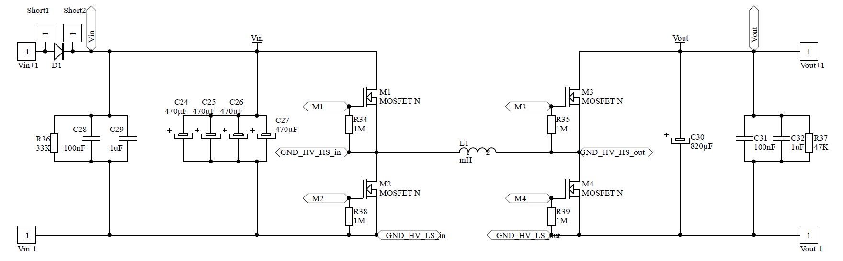
Power circuitry
Discharging resistors.
Protection diodes.
High frequency capacitors.

Slide 8
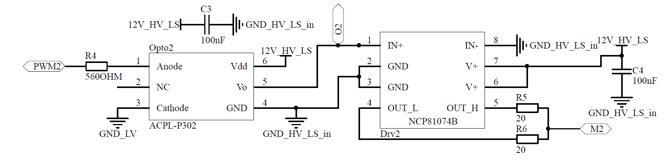
Driver circuitry
Optocouplers for isolation.
Decoupling capacitors.
Current limiting resistors.

Slide 9
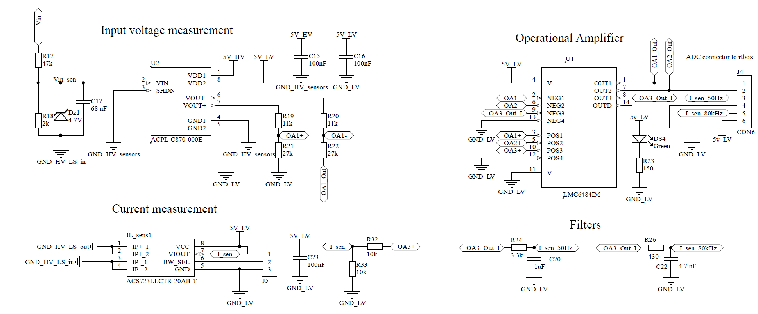
Sensor circuitry
Notes:
Optical unity-gain amplifier – voltage sensors
Hall effect – current sensor

Slide 10
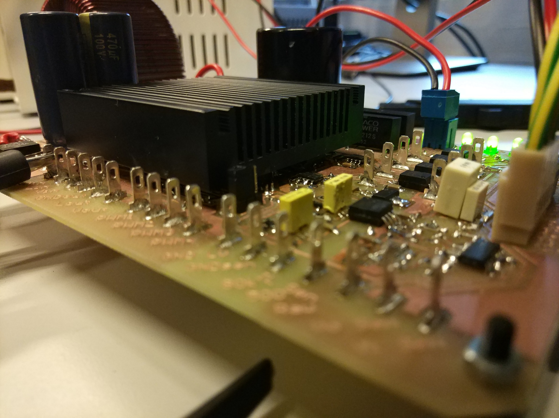
Power supplies
External supplies
Linear 5V voltage regulator
Isolated 12V TRACO supplies
LED at every supply line

Slide 11
Future work
Hardware improvements
Inductor design
PCB improvements
Converter’s efficiency
V/I controller

Slide 12
Conclusion
Add something about the general intro?
What went good
What went bad
What did we learn

